Slide 1
Prototype Development (Low Fidelity)
Dr. Glory Aguzman, S.Sos, M.M., CDMS, CCP

Slide 2
Subtopics
Robust Design Concept
Robust Design Example
What Is Your Robust Design
Student Activities
Next Session Preparation

Slide 3
Acknowledgement
Karl Ulrich and Steven Eppinger and Maria C. Yang. (2020). Product Design and Development, 7th Edition. McGraw-Hill Education. New York. ISBN 978-1-260-04365-5, Chapter 14,15
https://study.com/academy/lesson/robust-design-definition-examples.html

Slide 4
Learning Outcome
LO2: Test the prototype to assess business potential.

Slide 5
Robust Design Concept
Definition:
Robust design is an approach to product development that ensures consistent performance even when faced with variability in materials, manufacturing, or usage conditions.
Difference between strong and robust design:
strong = resistant; robust = adaptable.
Taguchi Method:
a statistical approach to find the most stable design configuration.
Why it matters:
improves quality, reliability, and customer satisfaction.

Slide 6

Robust Design Example

Slide 7
Robust Design Example

Slide 8
Robust Design Identification Factors Example
Factor Type | Definition | Guiding Questions | Typical Examples
Control Factors (C) | Variables that the designer, engineer, or business can control or adjust during design or production to achieve the desired outcome. | What design parameters can we change or set to improve performance? Which factors are within our control (e.g., material, layout, process)? | Material selection (plastic, metal, alloy) Component dimensions or shape Software algorithm or user interface design Assembly pressure, torque, or temperature setting Product packaging method
Noise Factors (N) | Uncontrollable or difficult-to-control variables that cause variation in performance. These may come from the environment, user behavior, or manufacturing inconsistencies. | What external conditions might change during use or production? What factors could cause inconsistency or defects? What cannot be easily standardized or predicted? | Ambient temperature / humidity User handling or misuse Supplier variation in materials Machine wear / aging Power fluctuation, vibration, dust, or noise Network connectivity (for digital services)
Signal Factors (S) | Inputs or actions that come from the user or operating conditions. They define how the system is used and influence the output response. | What user input triggers or controls the system? What range of operation does the user set? How does user behavior affect performance? | Speed setting on a blender Pressure applied to a brake pedal Amount of data processed by an app Volume level in a speaker system Time of day the service is used
Output Responses (Y) | The results or performance measures of the system — what you want to keep stable and consistent even under variation. | What is the key measurable outcome ? What defines “good performance”? | Temperature retention in a bottle Strength or durability of a component App loading time Battery life Customer satisfaction or delivery time consistency

Slide 9
Robust Design Identification Factors Example
Example (Filled-In for a Physical Product)
Product: Portable Bluetooth Speaker
Factor Type | Example | Description / Impact
Control Factor | Speaker material and casing design | Affects vibration control and sound quality.
Noise Factor | User volume setting | Excessive use at high volume causes distortion or overheating.
Signal Factor | User-selected volume level | Defines how loud the speaker will play.
Output Response | Sound clarity and battery endurance | Desired outputs that should remain stable under variation.

Slide 10
Robust Design Identification Factors Example
Example (Filled-In for a Digital Service)
Service: Online Food Delivery App
Factor Type | Example | Description / Impact
Control Factor | App server capacity and algorithm efficiency | Determines speed and response time.
Noise Factor | Internet connection stability | Affects app performance, especially in rural areas.
Signal Factor | Number of active users placing orders | Main input that varies depending on customer demand.
Output Response | Order completion time & user satisfaction | Should remain stable despite load variations.

Slide 11
Robust Design Identification Factors Example
Example (Filled-In for Service)
Service: Laundry Services
Factor Type | Example | Description / Impact
Control Factor | Variables that can be controlled or adjusted by the laundry management to achieve consistent and high-quality cleaning results. | Type and dosage of detergent/softener Water temperature and washing duration Dryer spin speed (RPM) Machine load capacity (kg per cycle) Sorting procedures by color and fabric type Labeling or barcode tracking system for each orde
Noise Factor | Uncontrollable or difficult-to-control variables that cause variation in washing results. | Weather or humidity (affecting drying time) Power or water pressure fluctuations Machine wear and tear Sudden increase in customer orders Customer behavior (unclear instructions, late pickup) Internet or system connectivity issues
Signal Factor | Inputs or actions coming from the customer that influence the washing process and outcomes. | Type of service (regular, express, dry clean) Laundry weight and fabric type Special instructions (no fragrance, cold wash, specific folding style) Pickup and delivery schedule requested by customer
Output Response | The measurable results or performance indicators that must remain stable and meet customer expectations. | Cleanliness of clothes (stain removal, fresh scent) Turnaround time for orders On-time delivery rate Error rate (lost/mixed-up clothes) Customer satisfaction ratings

Slide 12
What Is Your Robust Design Factors?
Product Or Service: ?
Factor Type | Indicators | Description / Impact
Control Factor
Noise Factor
Signal Factor
Output Response

Slide 13
Student Activities
Create Robust Design Factor Identification Factors
Present Prototype (Sketch, Video, Picture, Dummy or MVP)
Present Robust Design Factor Identification Factors
Lecturer Give Feedback to Groups

Slide 14
Next Session Preparation
Student Bring Prototype
Prototype Testing (Customer Discovery)
Prototype Testing Report

Slide 15
Prototype Testing (Customer Discovery)
Prepare several prototype versions
Decide the team roles:
Moderator: explains the context and asks questions.
Actor: plays a role in the scenario.
Observer: observes and records the results.
Question for User
1. Questions about the user experience
“How does it feel when using this product?”
“Is it easy to use?”
“Which part do you find most interesting or enjoyable?”
2. Questions about user actions
“Why did you choose to press/slide/select that part?”
“What did you expect to happen when you did that?”
“Which part made you feel confused?”
3. Questions about usefulness
“Do you think this product helps with your needs?”
“In what situations would you use this product?”
“What is the biggest benefit you feel from this product?”
4. Questions for suggestions
“What should we improve?”
“If you could change one thing about this product, what would it be?”

Slide 16
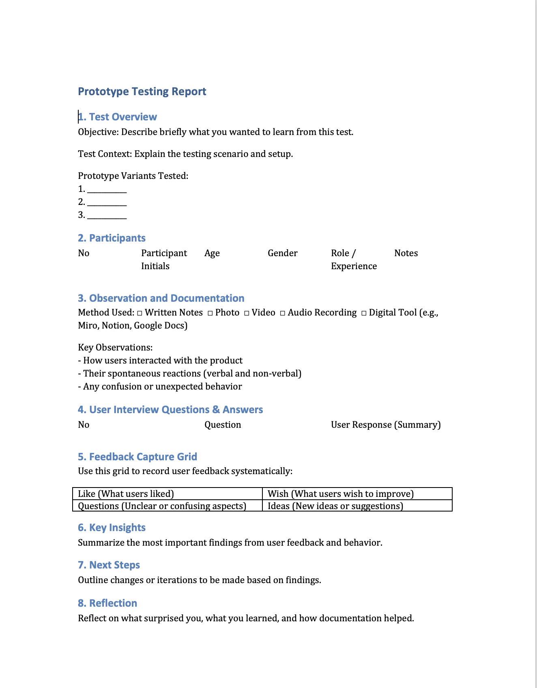
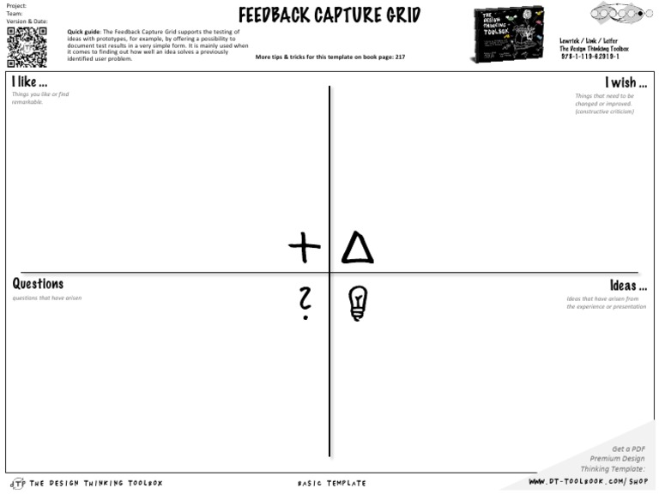
Prototype Testing Report

Slide 17
REFERENCES
Karl Ulrich and Steven Eppinger and Maria C. Yang. (2020). Product Design and Development, 7th Edition. McGraw-Hill Education. New York. ISBN 978-1-260-04365-5

